Slide 1
Tutorial 04 (Solution)
12 Feb 2024

Slide 2
Exercise from handout-2 (Paragraph 16):

Slide 3

Exercise from notes (Paragraph 16(a)):
Design a database system for a College of Pharmacy, Division of Clinical Pharmacokinetics. The division has research projects in various stages of development: current, pending, and complete. Each project is funded by a single grant. Usually, the major portion of this research grant is used to pay the study's subjects; the various drugs and equipment used in the experiments are often provided by one or more drug companies. A project studies the effects of the drug on several subjects, some of whom have unequal therapeutic regimes. Several employees of the College of Pharmacy work on each project, which is led by a principal investigator; each principal investigator may control several projects. When a study is completed, a research report is written, describing the results of the study.

Slide 4
List possible entities
College of Pharmacy,
Division of Clinical Pharmacokinetics
Projects -> Attribute -- stages of development
Grant
study's subjects -> Attribute therapeutic regimes
Drugs → Attribute Effects
Equipment
Experiments
Companies
Employees
?principal investigator
research report
results

Slide 5

Exercise from notes (Paragraph 16(a)):
Design a database system for a College of Pharmacy, Division of Clinical Pharmacokinetics. The division has research projects in various stages of development: current, pending, and complete. Each project is funded by a single grant. Usually, the major portion of this research grant is used to pay the study's subjects; the various drugs and equipment used in the experiments are often provided by one or more drug companies. A project studies the effects of the drug on several subjects, some of whom have unequal therapeutic regimes. Several employees of the College of Pharmacy work on each project, which is led by a principal investigator; each principal investigator may control several projects. When a study is completed, a research report is written, describing the results of the study.

Slide 6
List of possible relationships
project is funded by a grant
Grant pay subject
Grant pay equipment
Grant pay drug
Drug provided by company
Equipment provided by company
Drug are used in a project
Equipment are used in a project
Employee work on project
Project led by principle investigator
Report describes result of study

Slide 7
Relationships
Project is funded by a grant
Grant pay subject
Grant pay equipment
Grant pay drug
Drug provided by company
Equipment provided by company
Drug are used in a project
Equipment are used in a project
Employee work on project
Project led by principal investigator
Report describes result of study
Employees
Grant
( 0, 1 )
work on
PI
Fund
( 0, n )
Project
Entity
Equipment
Drugs
subject
Projects -> Attribute -- stages of development
Grant
study's subjects -> Attribute therapeutic regimes
Drugs → Attribute Effects
Equipment
Companies
Employees
?principal investigator
research report
results
Companies

Slide 8
Relationships
guides
Employees
PI
Project is funded by a grant
Grant pay subject
Grant pay equipment
Grant pay drug
Drug provided by company
Equipment provided by company
Drug are used in a project
Equipment are used in a project
Employee work on project
Project led by principal investigator
Report describes result of study
Grant
( 0, 1 )
supervise
work on
Fund
( 0, n )
Project
Entity
Equipment
Drugs
subject
Projects -> Attribute -- stages of development
Grant
study's subjects -> Attribute therapeutic regimes
Drugs → Attribute Effects
Equipment
Companies
Employees
?principal investigator
research report
results
Companies

Slide 9
Employee
Grant
(0,1)
(0,n)
(1,1)
Work
PI
Funds
(0,n)
(1,1)
(1,1)
Project
Using
Administer
Equipment
Drug
Subject
Company
effects
therapeutic regimes
©Dr Uday Reddy

Slide 10
Exercise from handout-2 (Paragraph 24):

Slide 11
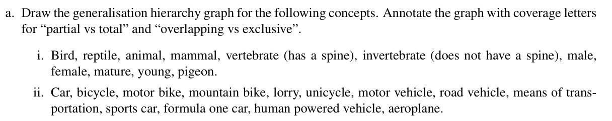

Slide 12
animal
(t, x)
vertebrate
invertebrate
(p, x)
Bird
mammal
reptile
(p, o)
(p, x)
(t, x)
Mature
Young
Egg
Hatchling
pigeon
male
female

Slide 13
means of
transportation
(t, x)
motor vehicle
human powered vehicle
(p, x)
(p, x)
boat
road vehicle
aeroplane
bicycle
unicycle
boat
(p, x)
(p, o)
Bus
lorry
Car
motor bike
mountain bike
(p, x)
Family
sports car
formula one car

Slide 14
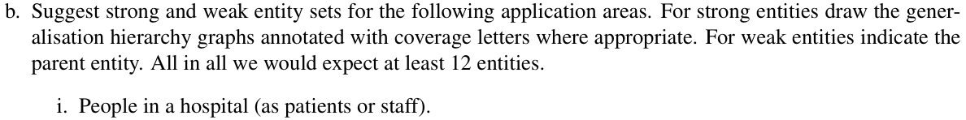
Person
(p,o)
Staff
Medical Record
Patient
(t,o)
(p,x)
Schedule/roster
Medical Staff
Admin Staff
Inpatient
Outpatient
(p,x)
(p,x)
Radiologist
Doctor
Nurse
Billing
Cleaning
Lab

Slide 15
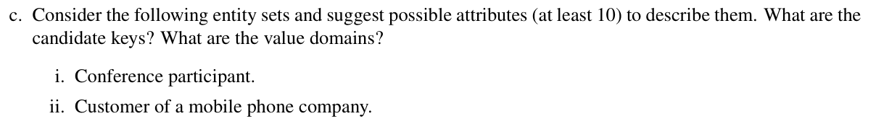
Conference Participant
Conference Participant | Domain
1. Participant ID: Unique identifier for each participant. | Integer
2. Name: Full name of the participant. | String (text)
3. Email Address: Contact information. | String (text)
4. Organization: the participant belongs to. | String (text)
5. Role: Role of the participant in the conference (e.g., speaker, attendee, organizer). | String (text)
6. Registration Date: Date when the participant registered for the conference. | Date
7. Payment Status: Indicates whether the participant has paid the registration fee. | Boolean
8. Dietary Restrictions: Any dietary restrictions or preferences of the participant. | String (text)
9. Accommodation Preferences | String (text)
10.Special Requests: Any special requests or requirements the participant may have | String (text)

Slide 16
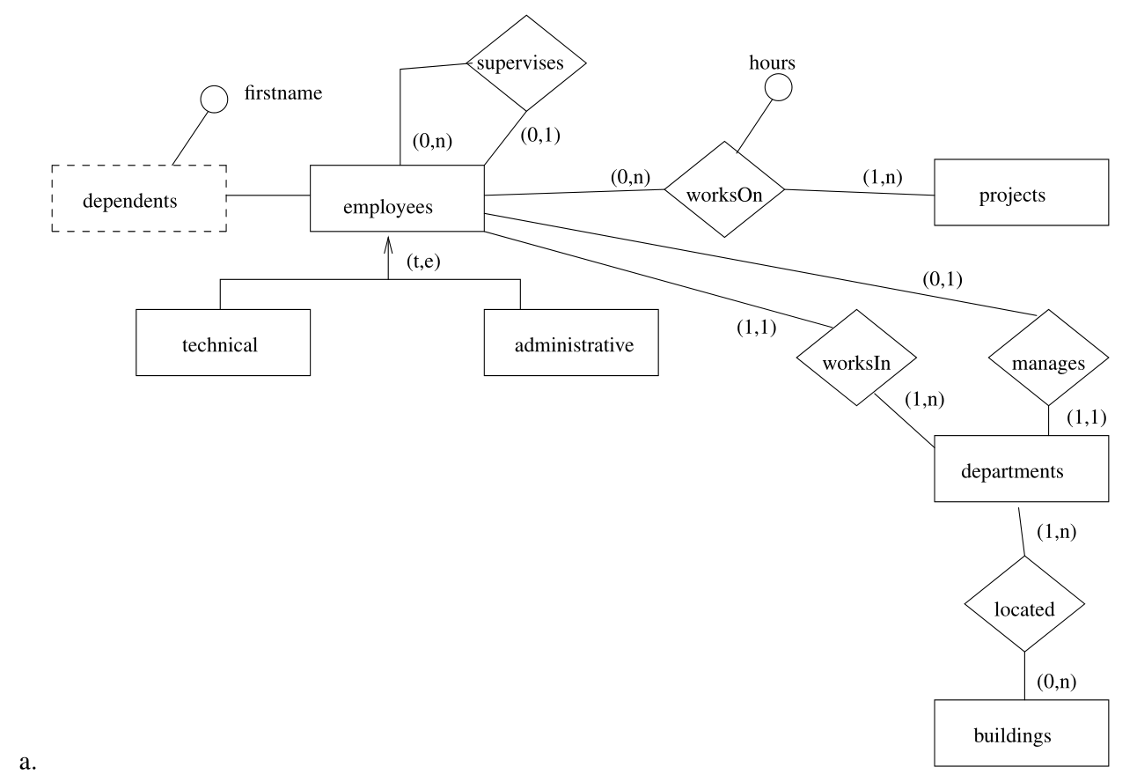
Entity-Relationship diagram. Annotate with multiplicities.

Slide 17
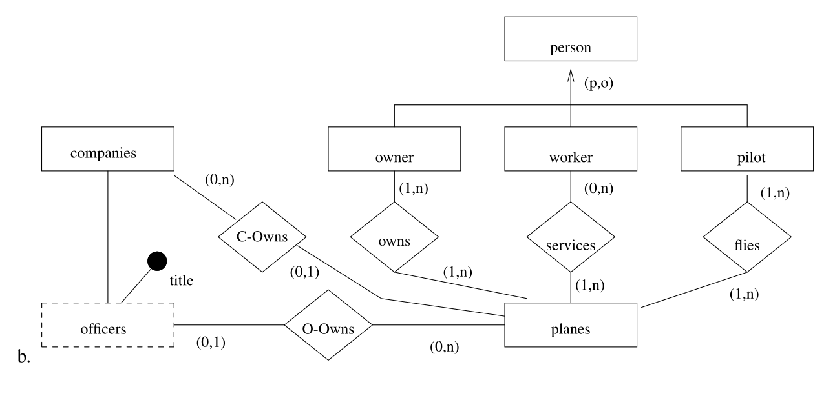
Entity-Relationship diagram. Annotate with multiplicities.

Slide 18
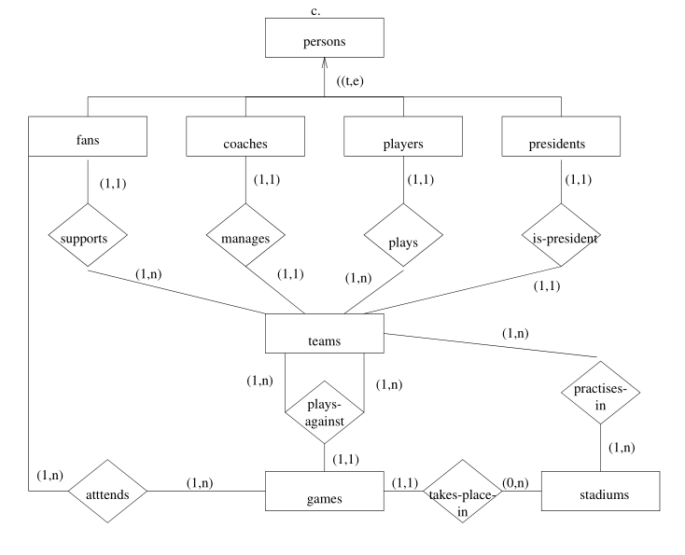
Entity-Relationship diagram. Annotate with multiplicities.

